Slide 1
Development of a Calibration Procedure for the EyeLink 1000 Plus Eye Tracker
Asha Babu Prof. Dr. Daniel J. Strauss, Dr. Farah I. Corona Strauss
5.10.2024, Alt Saarbruecken./ Project Work

Slide 2
Contents
History of Eye Tracking
Basic Principle of video-based Eye Tracking
Pupil - CR Technique
Role of Thresholds
Materials and Methods
Experiment Details
Data Processing and Results
Discussion
Conclusion and Future Work
References
1

Slide 3
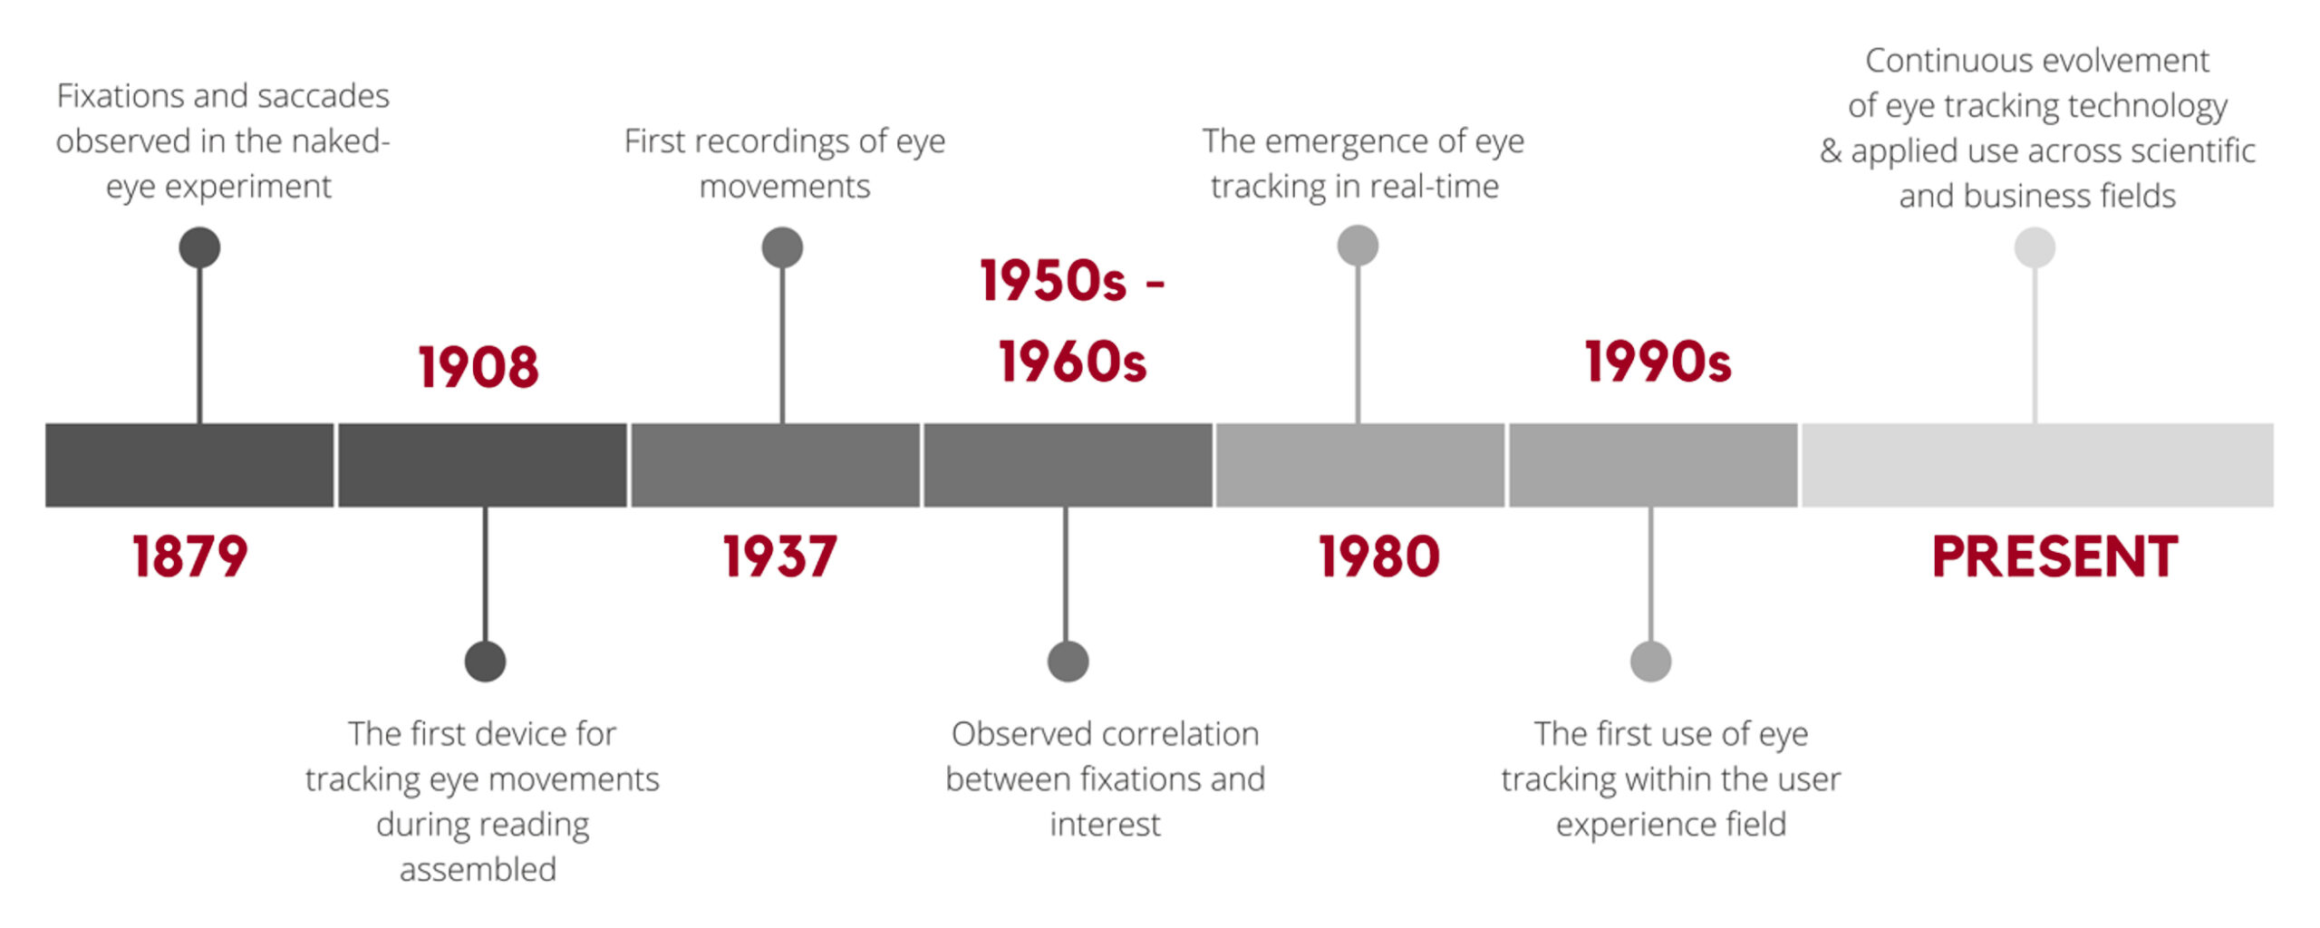
History of Eye Tracking
Fig 1. History of Eye Tracking [1]
2

Slide 4
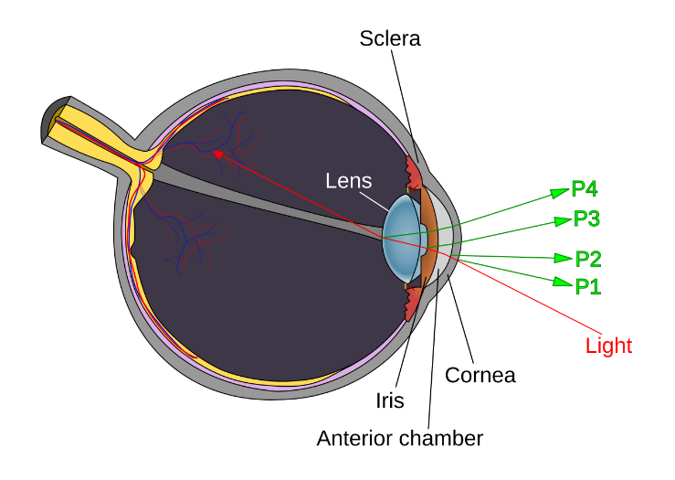
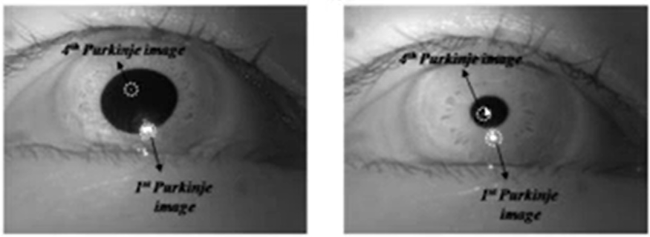
Basic Principle of Video-based Eye Tracking
Purkinje Images – reflection of bright light source seen in the eye.
1st Purkinje Image – The front surface of the cornea
2nd Purkinje Image – Rear surface of the cornea
3rd Purkinje Image – The front surface of the lens
4th Purkinje Image – Rear surface of the lens
Video-based eye trackers locate the first Purkinje image
Fig 2. formation of Purkinje Images [17]
Fig 3. Purkinje Images [7]
3
Notes:
The primary objective is to gain a comprehensive understanding of the eyelink 1000 plus system and its calibration process.

Slide 5
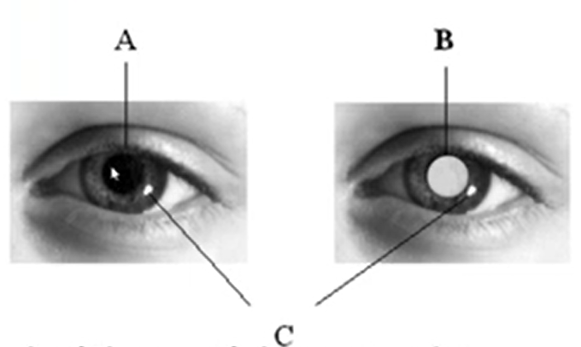
Basic Principle of Video-based Eye Tracking
High-speed video camera at the eye
Record the live images of the eye
Use image processing techniques to extract the features from these images (Key-landmark)
Dark Pupil and Bright Pupil techniques
Fig 4. Dark pupil(A) and bright pupil(B) with Corneal Reflection(C) [8]
4

Slide 6
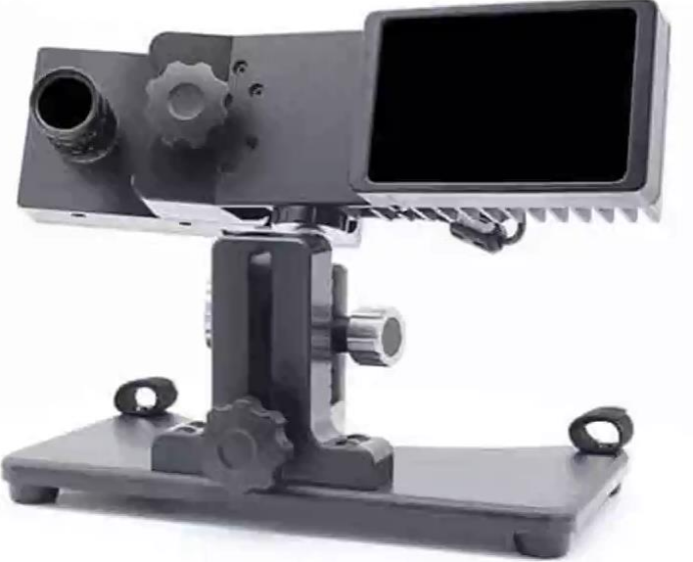
Components
An infrared light source
A high-speed video camera(operates in the infrared spectrum)
The host PC Eyelink software
Fig 5. Camera and IR light [14]
5

Slide 7
Components
IR light Source illuminates the eye and provides corneal reflection
High-speed camera takes up to 2000 pictures of the eye per second.
Host PC receives and processes the images from the camera and computes gaze location.
6
Notes:
The accuracy of eye tracking relies on a precise annotation of the pupil center and the corneal reflection
Near-infrared light is invisible to the human eye – it does not cause discomfort or distract the person in front of the eye tracker.
Near-infrared light interferes less with ambient light compared to the visible spectrum. This assures reliable and accurate illumination of the cornea, making eye tracking results stable in different environments.

Slide 8
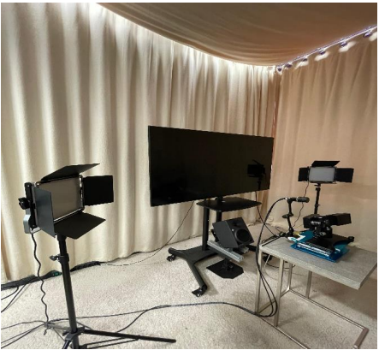
Components
To avoid uncertain local illumination we provided our lighting conditions.
7
Fig 6. Local Illumination

Slide 9
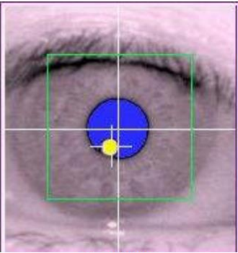
Pupil - CR Technique
Black and white digital camera consisting of a sensor that has thousands of “Pixels”
Photons fall on these pixels and generate voltage(low or high depends on the level of light)
Camera “image” is a spreadsheet containing the voltage values for each pixel
Two points of reference -To separate eye movement and head movement
Pupil centre
Corneal reflection
Fig 7. Centre of the pupil and CR [8]
8

Slide 10
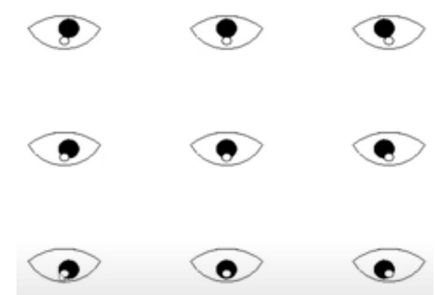
Pupil - CR Technique
Positional difference between the pupil centre and corneal reflection changes with eye rotation but remains relatively constant with minor head movements.
Fig 8. When the Position of CR eye rotates. [7]
9
Notes:
It uses the dark pupil technique for precise eye tracking. Tracks gaze position by correlating pupil and corneal reflection (CR).

Slide 11
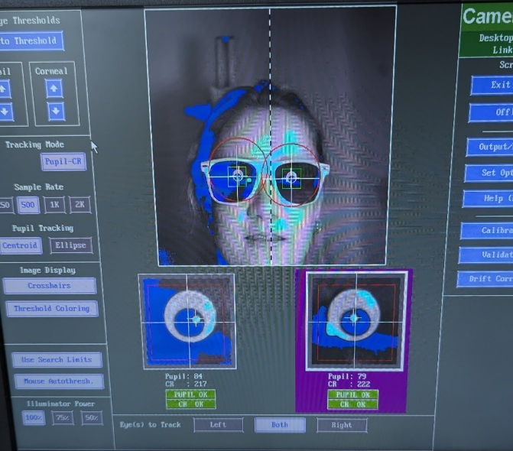
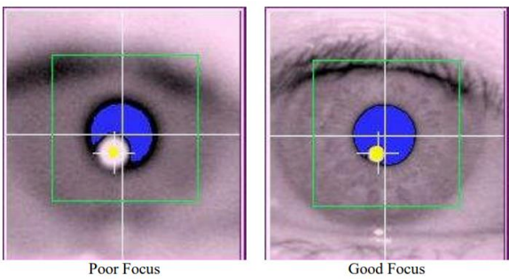
Role of Thresholds
The Centre of the pupil is estimated based on thresholded pixels.
Pupil and CR thresholds are greyscale values varying from 0 (black) to 255(white).
Here, the idea is to feed the host PC how black or white something must be considered as Pupil or CR.
Fig 9. Focusing the Camera. [7] and fixing the centre of the camera
10
Notes:
Eye tracking is widely used in fields such as psychology and neuromarketing to understand attention, visual behavior, and human behavior. Current calibration procedures are complex, time consuming and may lead to errors. Simplify the process for new users

Slide 12
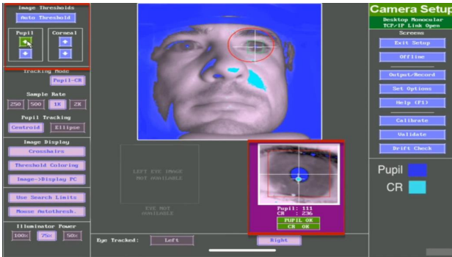
Role of Thresholds
Fig 10. Pupil and CR adjusting the monitor [13]
11

Slide 13
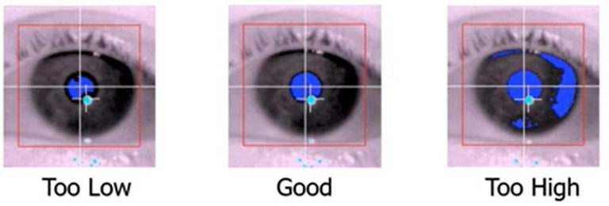
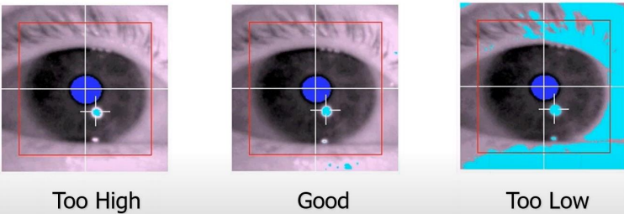
Role of Thresholds
Fig 11. Different pupil thresholds [8]
Fig 12. Different CR thresholds [8]
12

Slide 14
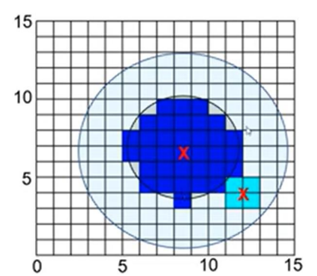
Role of Thresholds
Heart of the eye tracing
Fig 13. Pixels detected on the camera [8]
13

Slide 15
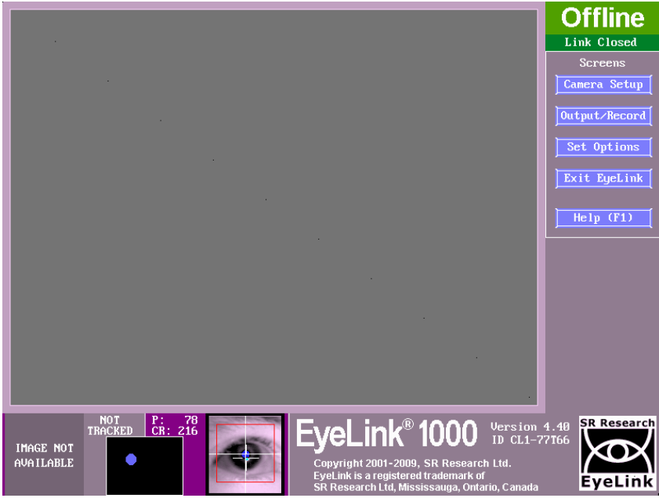
Camera Setup
Fig 16. Offline Screen Image [8]
14

Slide 16
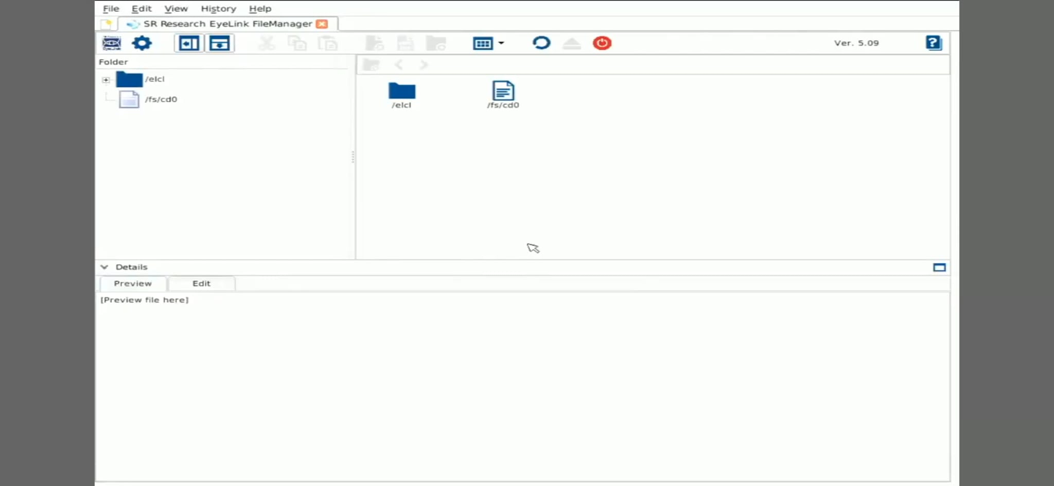
Setup
Fig 15. Configuration window [15]
15

Slide 17
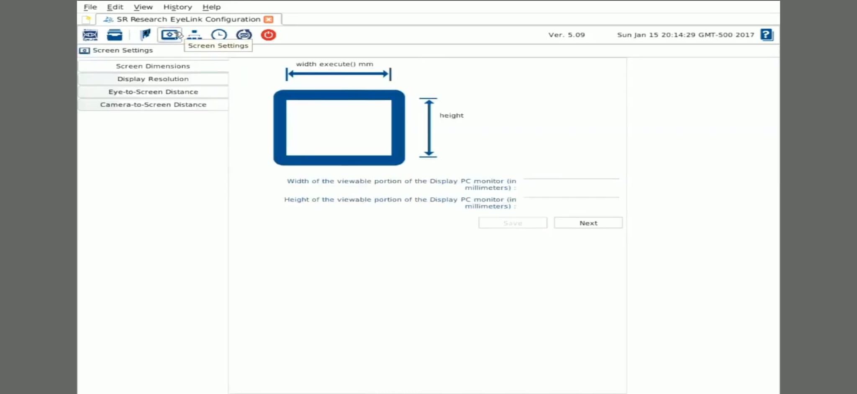
Camera Setup
16
Fig 15. Screen Settings Window [15]

Slide 18
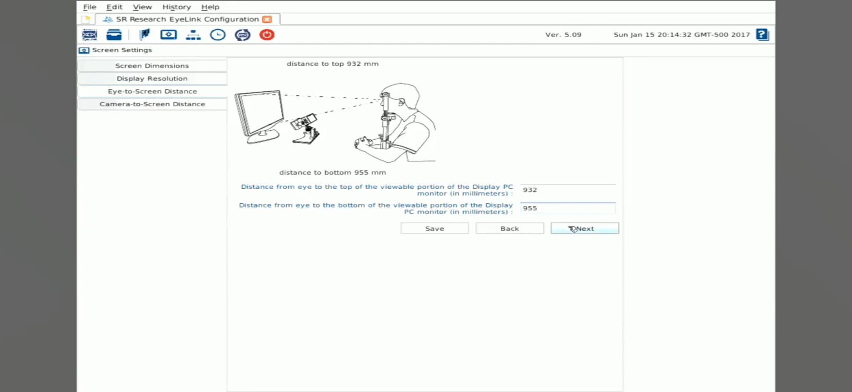
Camera Setup
Fig 17. Eye-to-screen distance window [15]
17

Slide 19
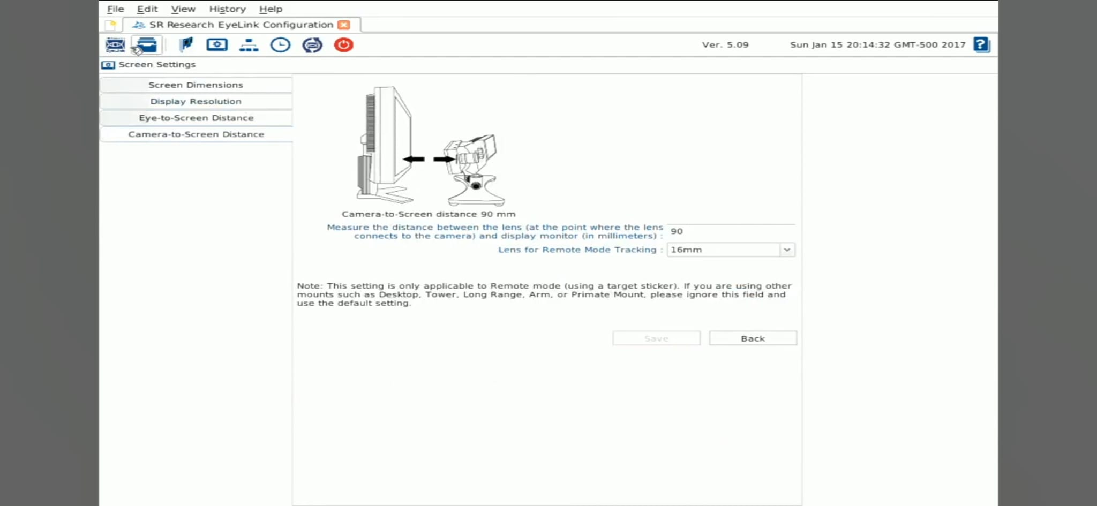
Camera Setup
Fig 18. Camera-to-screen distance window [15]
18

Slide 20
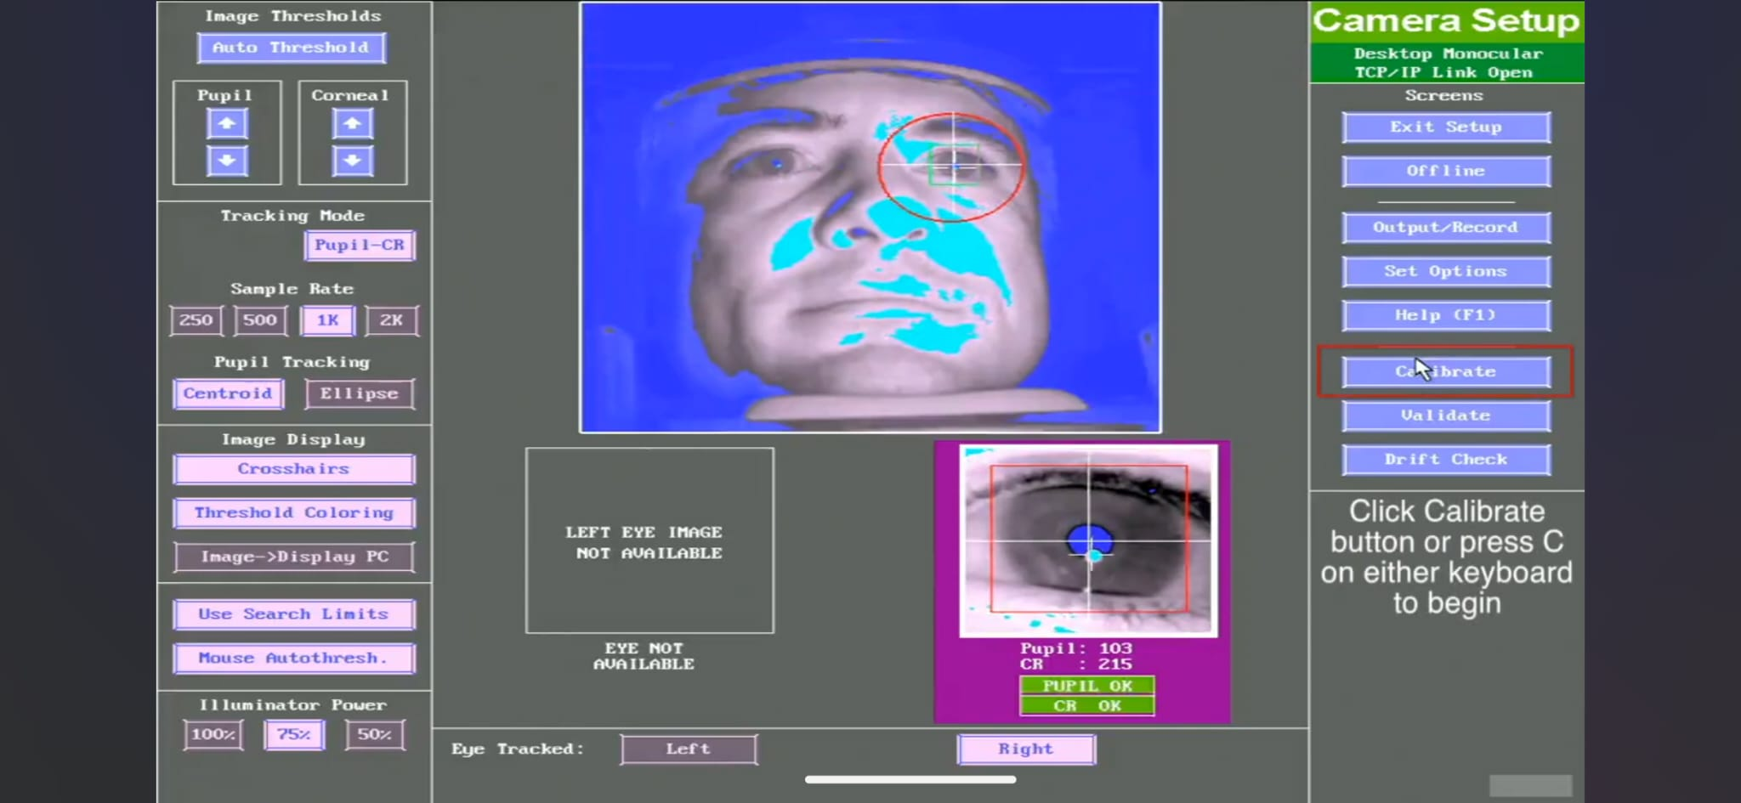
Calibration
Fig 19. The Calibrate button on the monitor [14]
19

Slide 21
Calibration
Map the eye's position on the camera to a specific point on the display screen.
Multiple target points (3, 5, 9, or 13 points) are used.
Validation ensures that the calibration is accurate for experimental data collection.
20

Slide 22
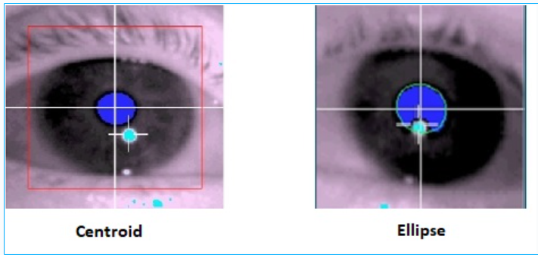
Calibration
The Centroid tracking mode calculates the pupil center as the centre of mass of the blue thresholded pupil area.
The Ellipse tracking mode calculates a best-fit ellipse around the blue thresholded area of the pupil (seen as a green ellipse on the Host PC), and uses the center of this ellipse as the pupil center.
Fig 20. The Calibrate button on the monitor [18]
21
Notes:
The Ellipse tracking mode may provide a better calculation of the true center of the pupil compared to Centroid tracking mode when the pupil is partially occluded, such as by the eyelid (as can happen when the pupil is very dilated, or in elderly population with ptosis, or when participants are lying in an MRI scanner). Note: In Remote mode, the Ellipse tracking mode is always used.
In Head-Fixed mode, the Ellipse tracking mode is slightly noisier than the Centroid mode for the EyeLink 1000. For the EyeLink 1000 Plus and Portable Duo, the two modes have comparable levels of noise.

Slide 23
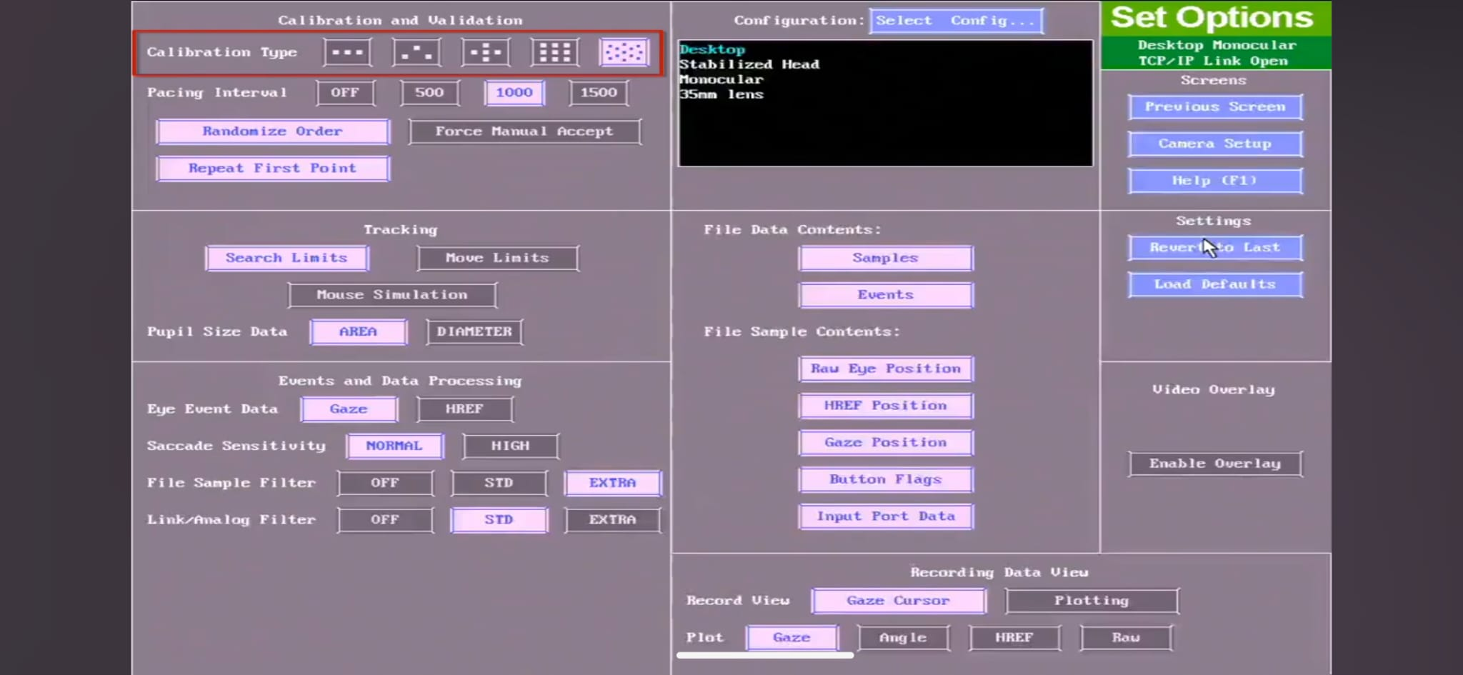
Calibration
Fig 21. Calibration model and pupil data size settings [14]
22
Notes:
Present targets (12,9,5 point model) for participants to fixate. Each fixation generates a mapping of pupipl- CR coordinates to screen pixels.

Slide 24
Calibration
The choice of diameter vs. area is really up to you and how you might prefer the data formatted. Neither is more accurate than the other, and you can convert between the two after data has been collected if you like.
The formula for the conversion of area to diameter is: pupil_diameter = 256*sqrt(pupil_area/3.14159)
The formula for the conversion of diameter to area is: pupil_area = [(pupil_diameter/256)^2]*3.14159
23

Slide 25

Calibration
Fig 22. Appeared target on the screen while the calibration [14]
24

Slide 26
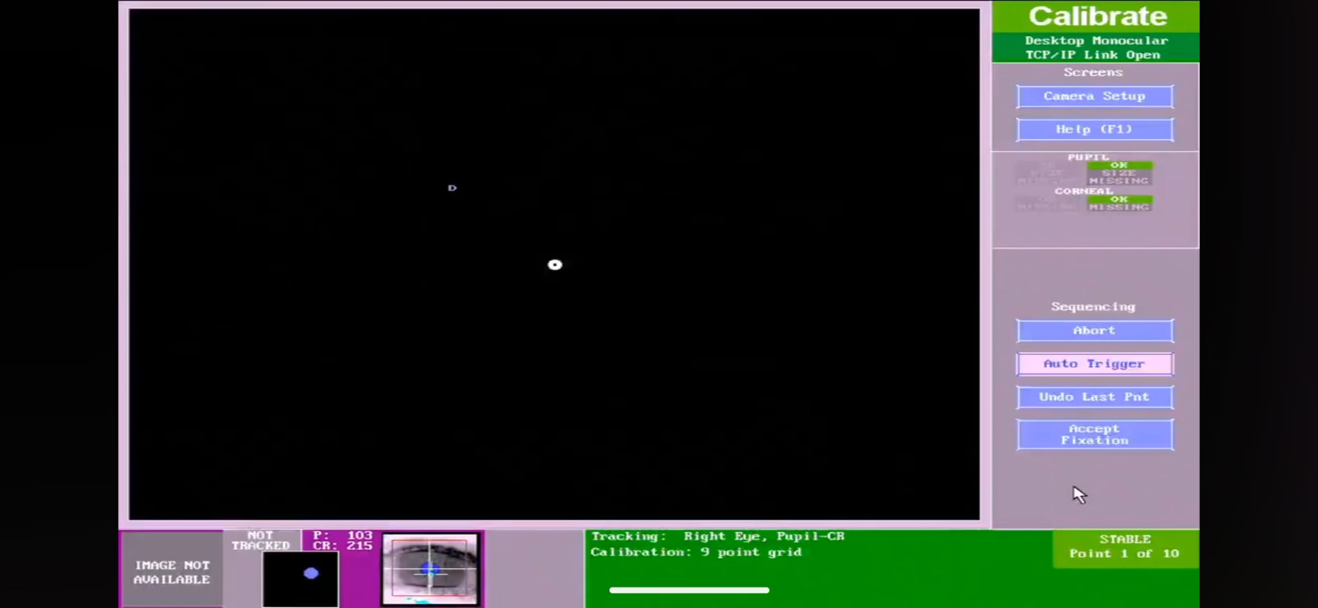
Calibration
Fig 23. Host PC calibration screen with cursor [14]
25

Slide 27
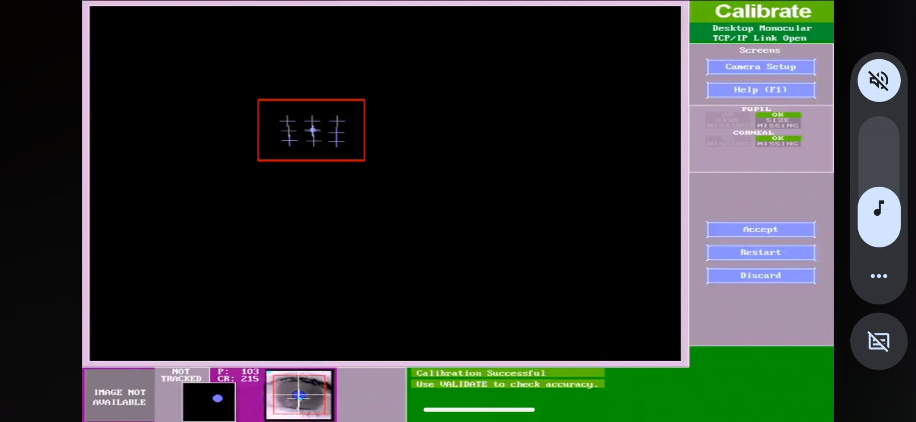
Calibration
Fig 24. 3*3 calibration grid in the Host PC [14]
26

Slide 28
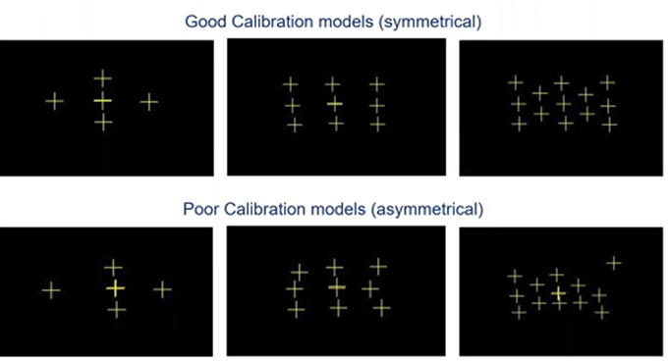
Calibration
Fig 25. Pixels detected on the camera [8]
27

Slide 29
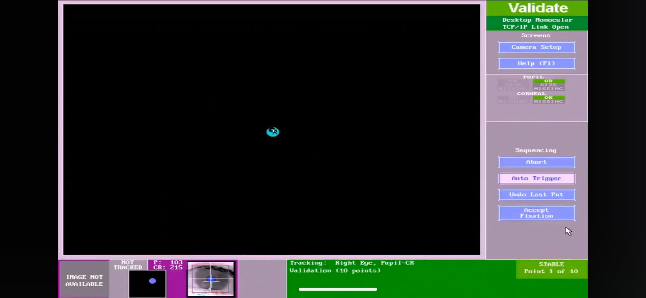
Validation
Fig 26. Validation gaze cursor in the Host PC [14]
28
Notes:
Ensures calibration accuracy by measureing gaze position error. Acceptable error: <= o.5 degrees average , ,+1.0 degrees max

Slide 30
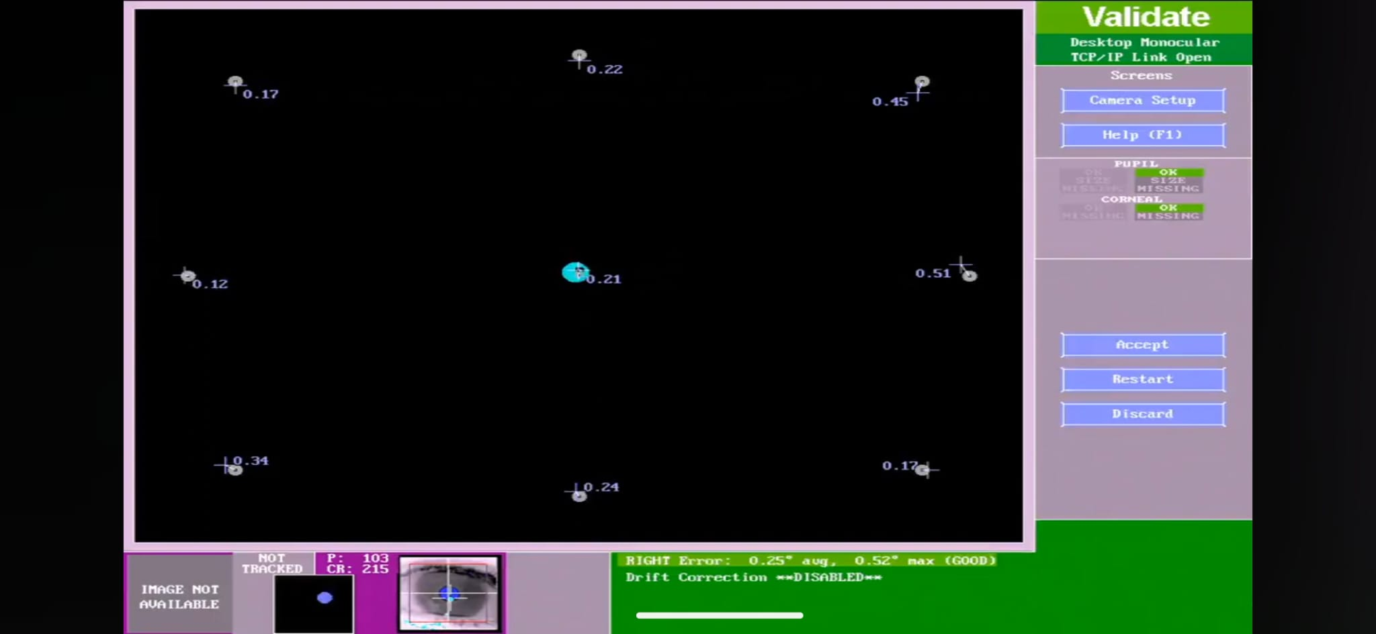
Validation
Fig 27. Validation of gaze cursor position with error values in the Host PC [14]
29

Slide 31
The info shared – Setup and Gaze
Goal – To find an effective calibration procedure for EyeLink 1000 Plus.
Relation between the arbitrary units and the pupil sizes.
30

Slide 32
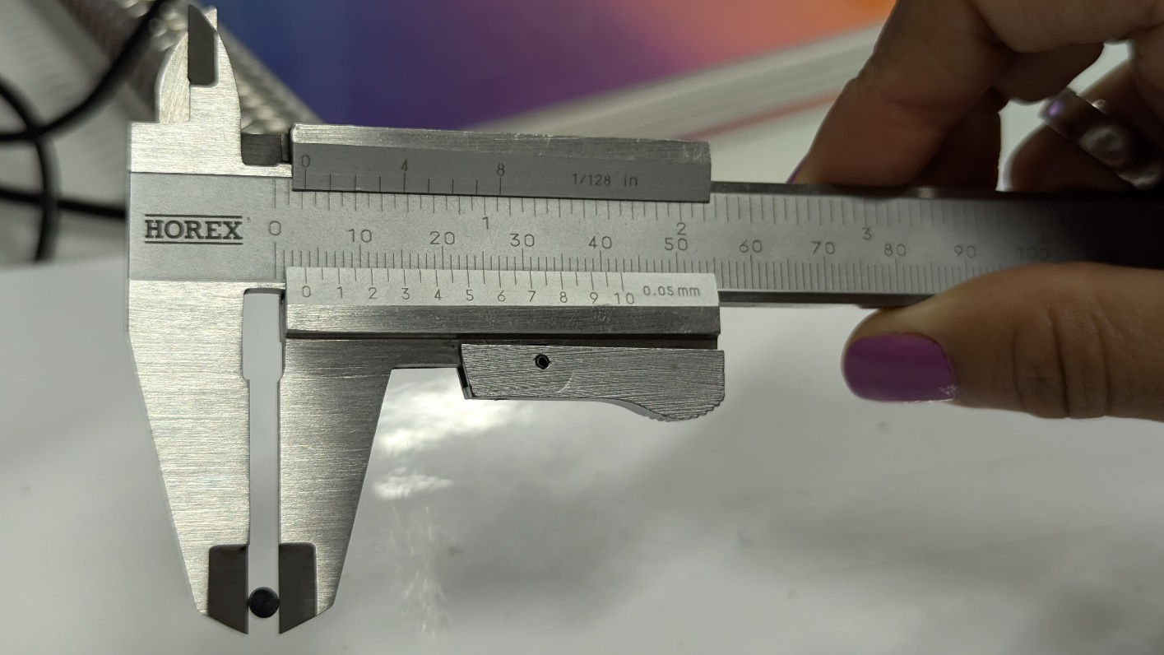
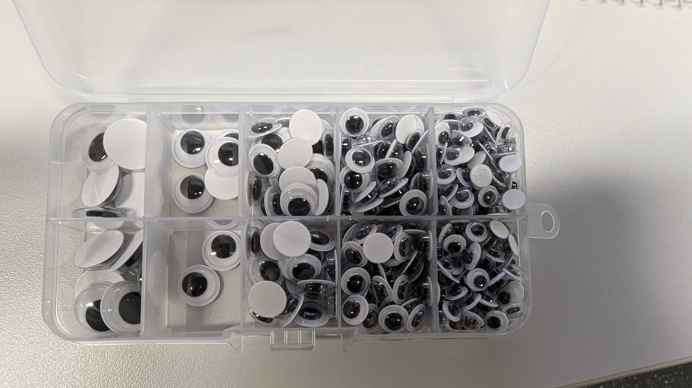
Materials and Methods
Phantom Eyes: Used to simulate the pupil at known sizes for calibration.
Measurement Tools: Vernier callipers to measure pupil diameter, laser meter for distance measurements, and artificial lighting to control illumination conditions.
Fig 28. Phantom eyes with a decrease in diameter
Fig 29. Measuring the diameter with a vernier calliper
31

Slide 33
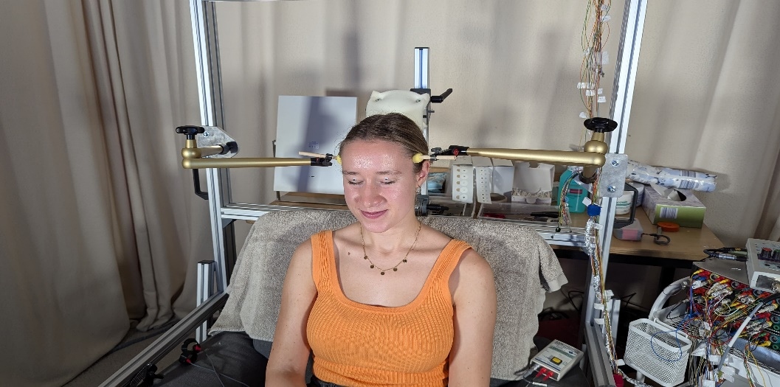
Materials and Methods
Fixed head position, controlled lighting, and precise measurements for calibration.
Ensure stable data by preventing head movement and measuring precise distances between participants and equipment.
32
Fig 30. A participant with artificial eyes attached.

Slide 34
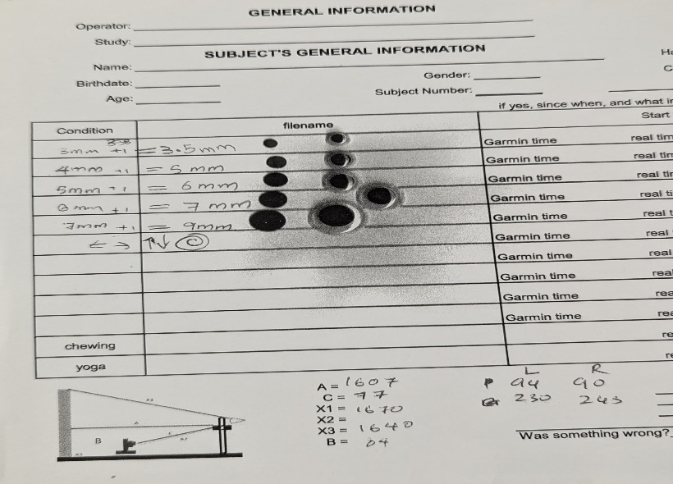
Materials and Methods
Fig 31. The physical data we measured
Pupil Diameter (mm) | Area (mm²)
3.5 | 9.6211
5 | 19.6350
6 | 282743
7 | 38.4845
9 | 63.6173
Table 1. Conversion of pupil size of phantom eyes into Area
33

Slide 35
Materials and Methods
To convert arbitrary Area units to mm, follow the given steps:
Use an artificial eye with a known pupil size. (we used a 7 mm diameter)
Place it at the eyelids of the participant and instruct not to move the eyes randomly.
Check that the pupil is detected on the screen of the host PC.
Record for a few seconds.
Take the average of this arbitrary unit to create a conversion factor.
34

Slide 36
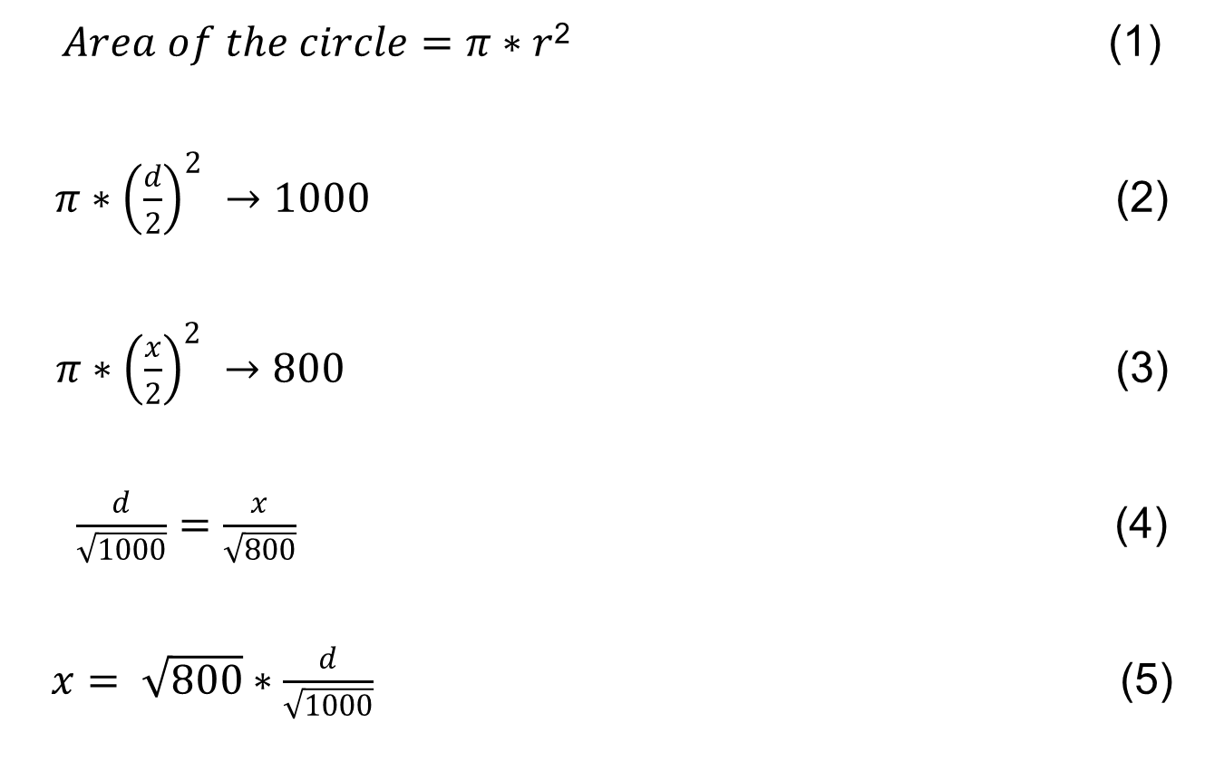
$Area of the circle=π∗r$² (1)
$π∗{\left(\frac{d}{2}\right)}^{2} →1000$ (2)
$π∗{\left(\frac{x}{2}\right)}^{2} →800$ (3)
$\frac{d}{\sqrt{1000}}=\frac{x}{\sqrt{800}}$ (4)
$x= \sqrt{800}∗\frac{d}{\sqrt{1000}}$ (5)
35

Slide 37
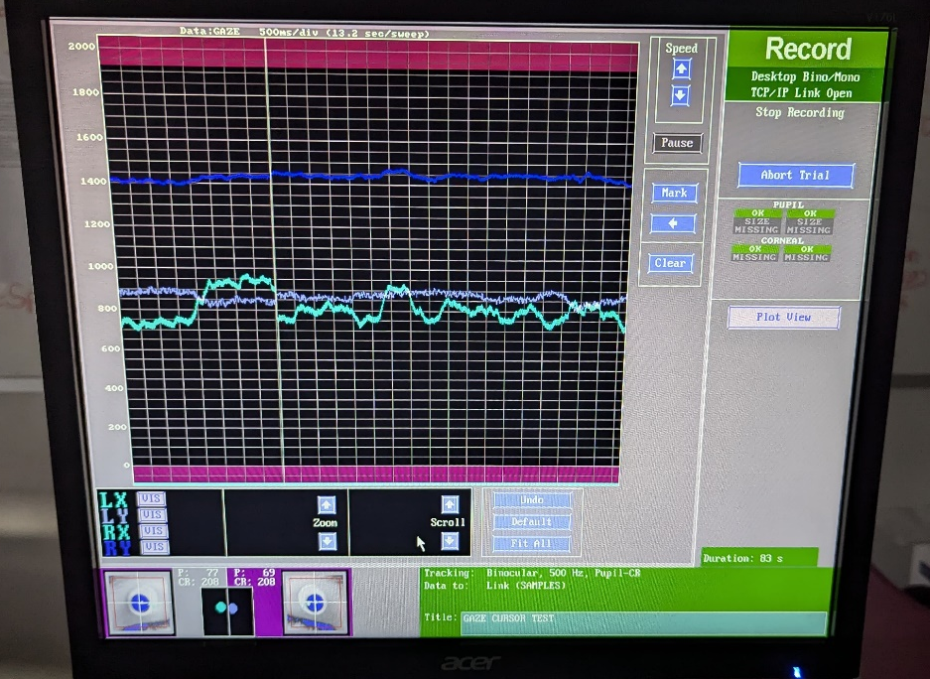
Materials and Methods
Fig 32. Host PC screen while recording
36

Slide 38
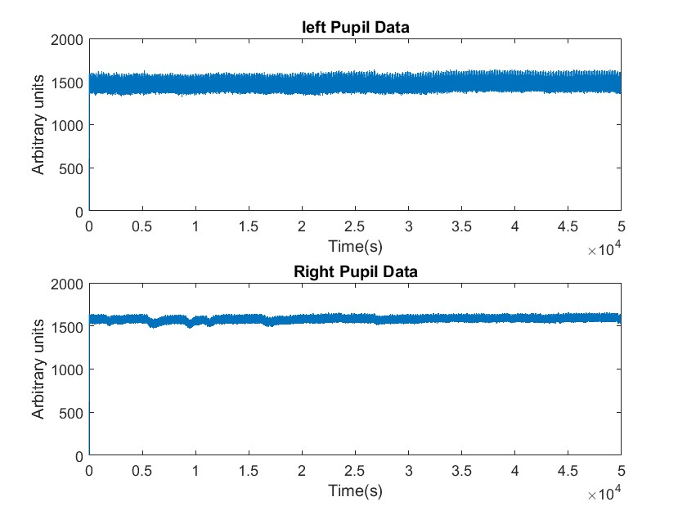
Materials and Methods
Fig 33. Raw data plotted in Matlab
37

Slide 39
Materials and Methods
Experiment 1
-- Tested 22 participants with a fixed 7mm pupil diameter to analyze threshold and distance effects.
-- A linear relationship between pupil area and arbitrary units was observed
Data Processing
- Downsample from 4800Hz to 500Hz.
- Smoothing data to remove noise.
- Segmenting data into standard 1-second Intervals for consistency.
38

Slide 40
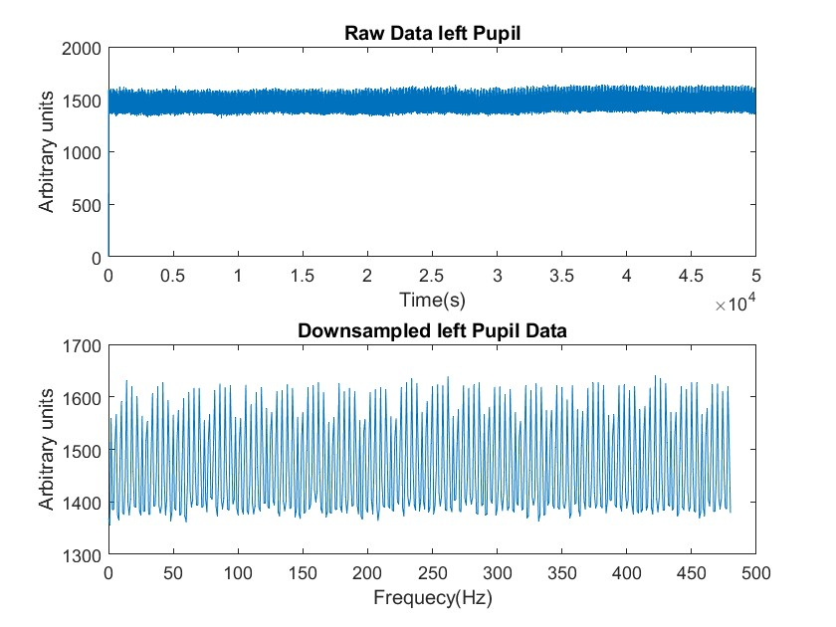
Results
y = downsample(x,n)
Fig 34. Comparison of raw and downsampled data
39

Slide 41
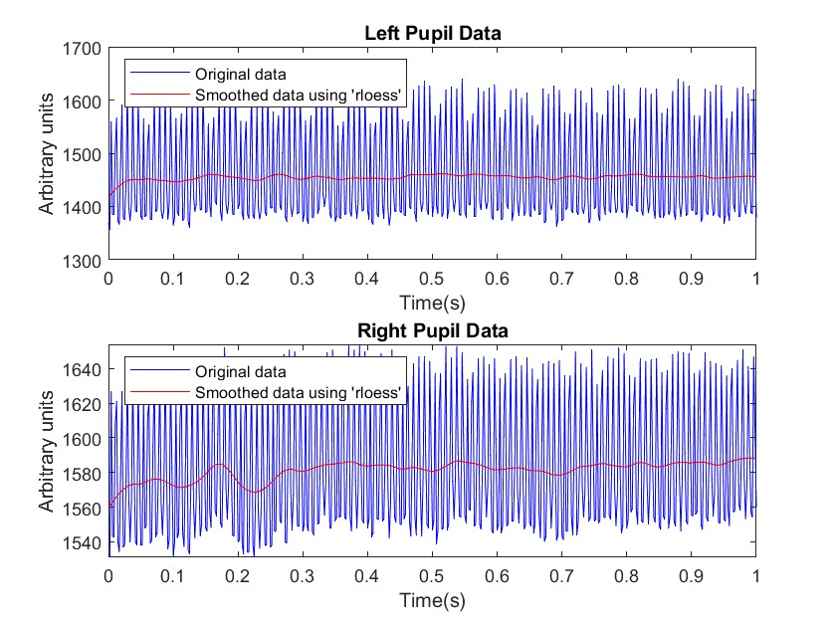
Results
B = smoothdata( A, method, window)
Fig 35. Data after applying smoothing and trimming
40

Slide 42
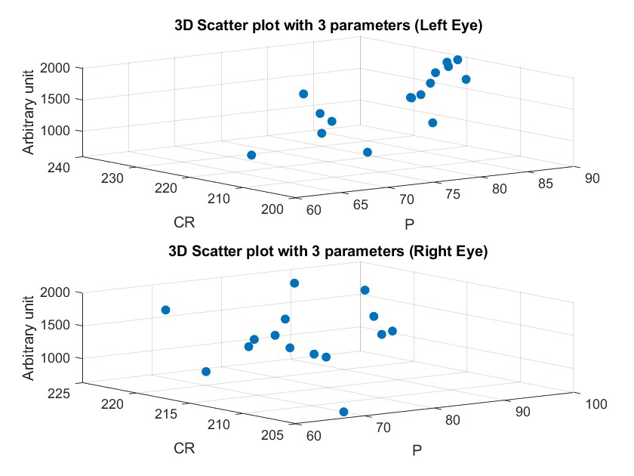
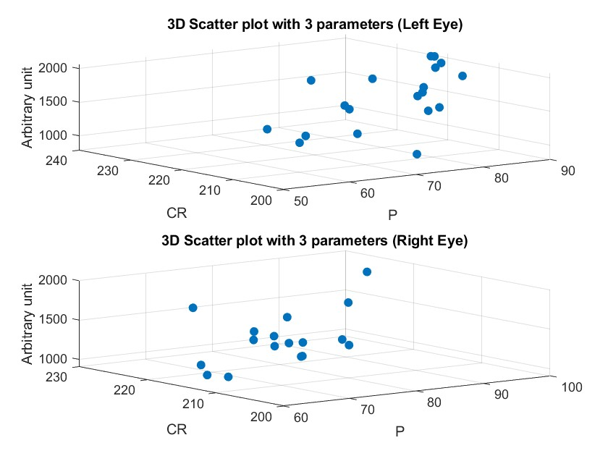
Results
Fig 36. 3D Scattered Plot of Pupil vs CR vs Arbitrary Units of repeated data
Fig 37. 3D Scattered Plot of Pupil vs CR vs Arbitrary units
41

Slide 43
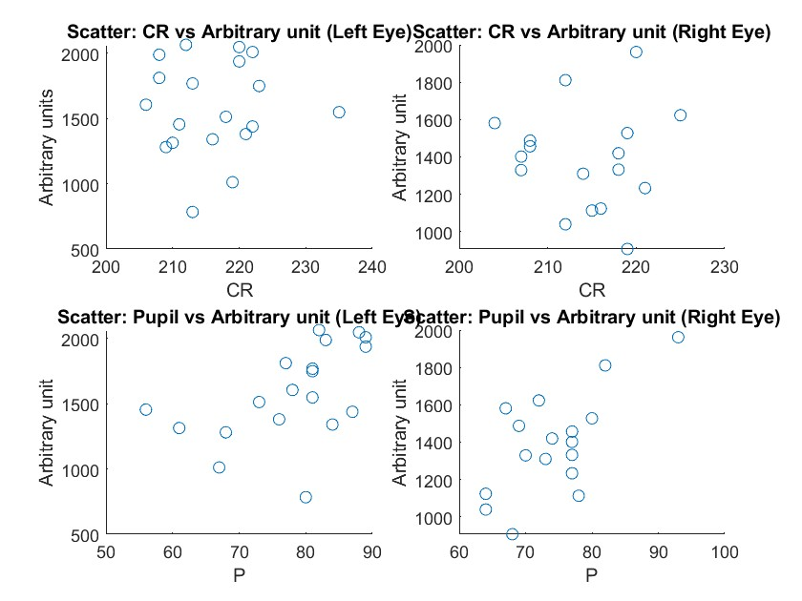
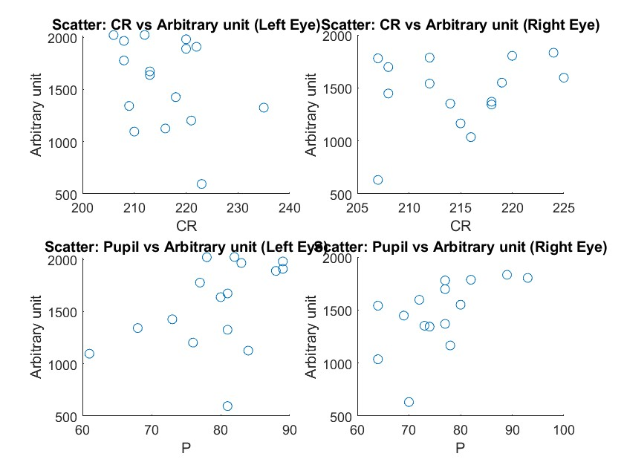
Results
Fig 38. 2D Scattered Plot of Pupil/CR vs Arbitrary units
Fig 39. 2D Scattered Plot of Pupil/CR vs Arbitrary units of repeated data
4

Slide 44
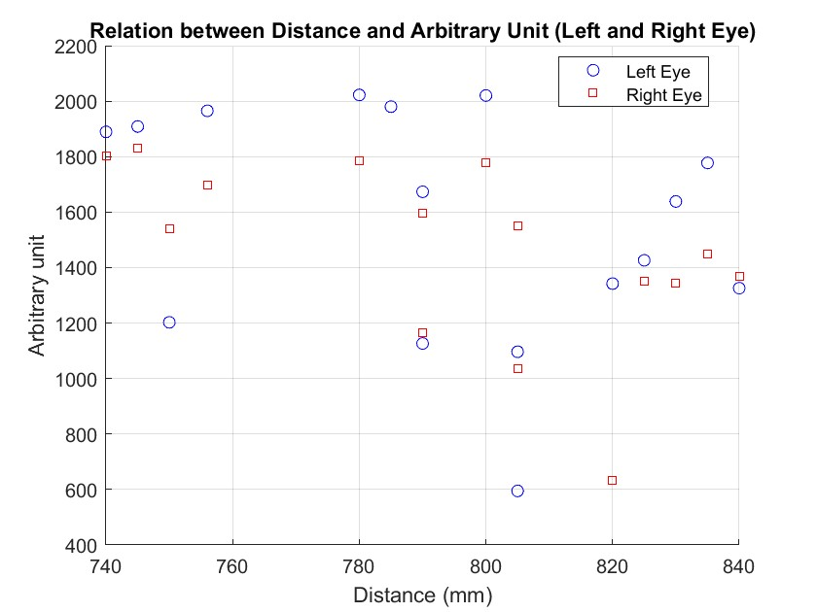
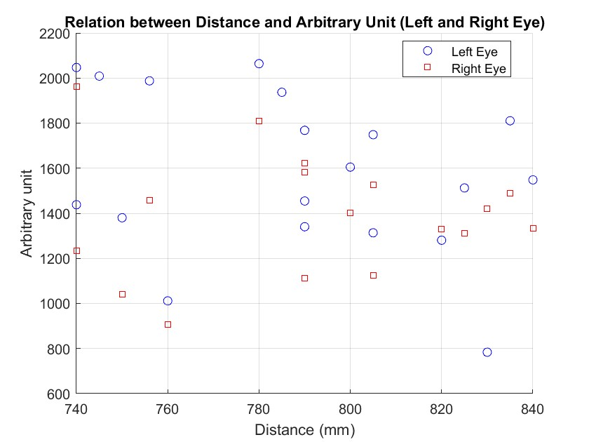
Results
Fig 40. 2D Scattered Plot of distance vs Arbitrary units
Fig 41. 2D Scattered Plot of Distance vs Arbitrary Units of repeated data
42

Slide 45
Results
Observed a linear relationship between pupil threshold and arbitrary units.
CR thresholds had less impact on the arbitrary units
43

Slide 46

Results
Experiment 2
-- 2 participants, varied pupil–CR thresholds and distances.
-- Used different-sized phantom eyes (3.5mm, 5mm,6mm,7mm,9mm).
-- Linear relationship confirmed between pupil size and arbitrary units.
-- Participant 1- Distance - 773mm, pupil threshold left - 120 and CR left – 227, pupil threshold right - 117 and CR - 228
-- Participant 2- Distance - 770mm, pupil threshold left - 94 and CR left – 230, pupil threshold right - 90 and CR - 243
Fig 42. Phantom eyes with a decrease in diameter
44

Slide 47
Results
Pupil Diameter (mm) | Area (mm²) | Arbitrary units Left Right |  | Arbitrary units inclined Left Right
3.5 | 9.6211 | 464 | 409 | 453 | 456
5 | 19.6350 | 1014 | 975 | 1115 | 1008
6 | 282743 | 1372 | 1355 | 1569 | 1435
7 | 38.4845 | 2172 | 2174 | 2221 | 1822
9 | 63.6173 | 3505 | 3179 | 3926 | 3438
Table 2. Pupil Area and Arbitrary unit normal and Inclined participant 1.
Pupil Diameter (mm) | Area (mm²) | Arbitrary units Left Right
3.5 | 9.6211 | 272 | 385
5 | 19.6350 | 887 | 726
6 | 282743 | 1433 | 1187
7 | 38.4845 | 1721 | 1729
9 | 63.6173 | 3202 | 3027
Table 3: Pupil Area and Arbitrary Unit of participant 2.
45

Slide 48
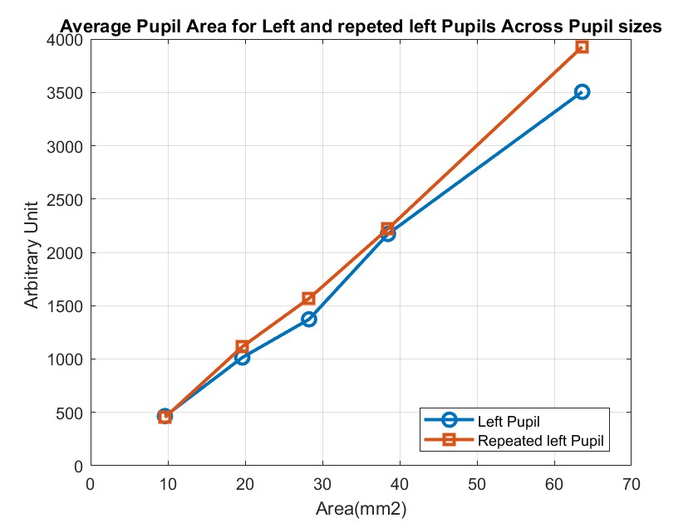
Results 1 Subject
Fig 43. Line Plot of Different Pupil Areas vs Arbitrary Units
46

Slide 49
Results
Larger pupil diameters increased arbitrary units, with a linear relationship.
We can fit this equation into the slope equation
y = mx + C
Where y is the arbitrary unit, x is the area in millimeter square, m is the slope and C is the constant.
We used polyfit(x,y,n) function which returns the coefficients for a polynomial p(x) of degree n
For the evaluation, we used polyval(p,x) also an inbuilt function to evaluate the polynomial p at each point in x.
47

Slide 50
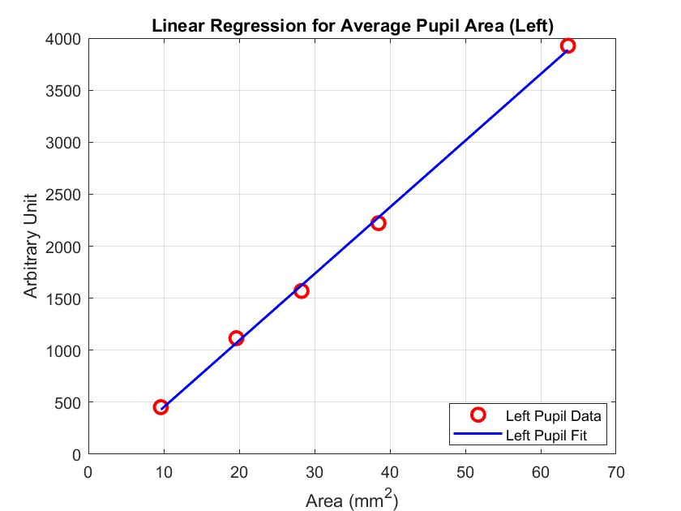
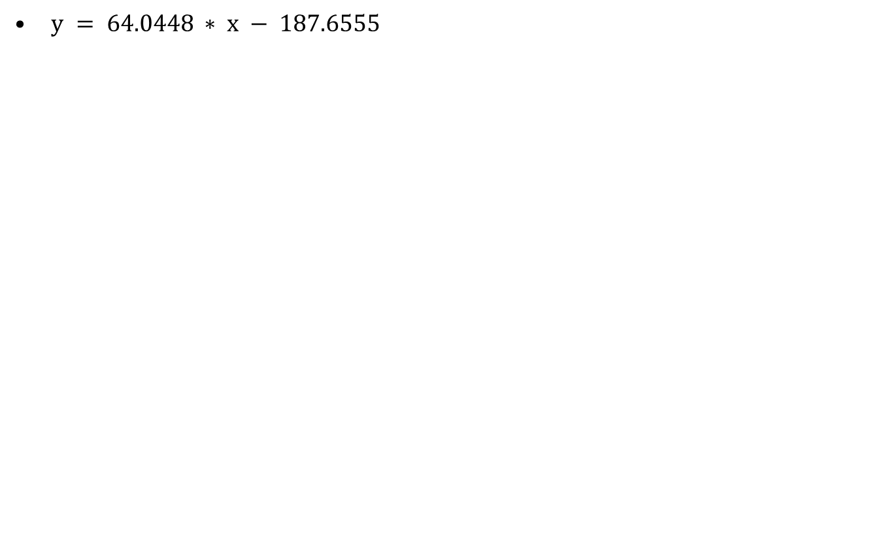
Results
$y = 64.0448 ∗ x − 187.6555$
Fig 44.Linear Regression of Pupil Areas vs Arbitrary Units of left eyes.
48

Slide 51
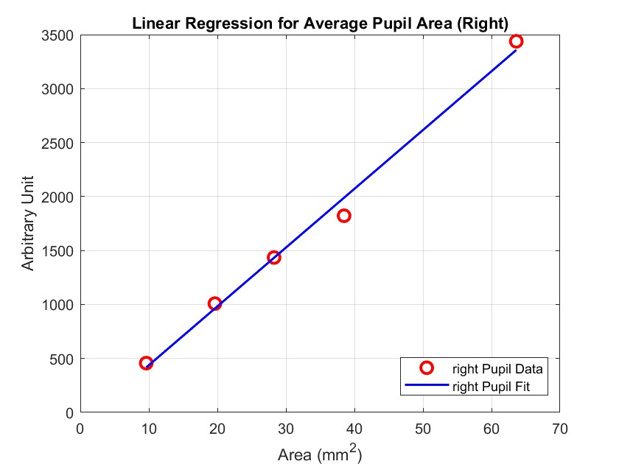
Results
y = 49.9629x + -183.8841
Fig 45. Linear Regression of Pupil Areas vs Arbitrary Units of right eyes
49

Slide 52
Results
For example, if the Arbitrary unit is 2000, the predicted arbitrary unit would be:
2000 = 49.9629*x + -183.8841
x ≈ 43.71 mm²
50

Slide 53
Discussion
Linear relationship established between pupil area and arbitrary units. Eye movement influences data accuracy.
Regression models validate the linear relationship, providing accurate predictions for varying pupil sizes.
Reliable calibration is crucial for collecting accurate eye-tracking data.
Minor head movements can affect data, but the developed regression model compensates
Variability due to differences in participant physiology and equipment placement.
51

Slide 54
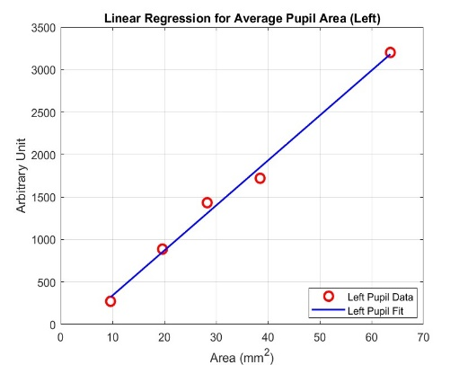
Conclusion
Efficient calibration and validation improve data reliability
Linear models provide accurate estimations of gaze positions.
Recommended procedure:
Relative area is more reliable than
area measures.
Future considerations
Automating calibration settings to reduce human error.
Integrating the EyeLink system with advanced cognitive research tools
Fig 46. Recommended procedure.
52

Slide 55
References
https://www.eyelogicsolutions.com/history-behind-eye-tracking/
JOUR AU - Holmqvist, Kenneth AU - Nyström, Marcus AU - Andersson, Richard AU - Dewhurst, Richard AU - Jarodzka, Halszka AU - van de Weijer, Joost PY - 2011/01/01 SP - T1 - Eye Tracking: A Comprehensive Guide To Methods And Measures VL - ER - J. Malmivuo and R. Plonsey. Bioelectromagnetism. Principles and Applications of Bioelectric and Biomagnetic Fields, 1995.
Schlegelmilch, K., & Wertz, A. E. (2019). The effects of calibration target, screen location, and movement type on infant eye-tracking data quality. Infancy, 24(4), 636–662.
Rosengren, William and Nyst, Marcus and Hammar, Bjrn and Stridh, Martin, Suitability of calibration polynomials for eye-tracking data with simulated fixation inaccuracies,2018.
Mark A. Mento, This is how eye-tracking technology works, https://www.bitbrain.com/blog/eye-tracking-technology, May 5, 2020

Slide 56
References
Ignace Hooge, Kenneth Holmqvist, Marcus Nyström, pupil is faster than the corneal reflection (CR): Are video based pupil-CR eye trackers suitable for studying detailed dynamics of eye movements? Vision Research, Volume 128, 2016.
EyeLink® 1000 Plus User Manual, https://www.hse.ru/mirror/pubs/share/560338728.pdf
https://www.youtube.com/watch?v=CnXuZSCd11Q&t=1419s
Adhanom, I.B., MacNeilage, P. & Folmer, E. Eye Tracking in Virtual Reality: a Broad Review of Applications and Challenges. Virtual Reality 27, 1481–1505 (2023). https://doi.org/10.1007/s10055-022-00738-z
Benjamin T. Carter, Steven G. Luke, Best practices in eye tracking research, International Journal of Psychophysiology, Volume 155,2020 https://doi.org/10.1016/j.ijpsycho.2020.05.010.
Andrew T. Duchowski, Springer International Publishing, Eye Tracking Methodology, Theory and Practice, 2017
https://www.sr-research.com/fmri-meg-systems/

Slide 57
References
Timon Dörzapf, Exploration of software tools used for analyzing eye tracking data in software engineering, October 10, 2023
https://www.sr-research.com/eyelink-1000-plus/
https://www.youtube.com/watch?v=M6vN22Asxq4&t=144s
Duchowski, A. T. (2017). Eye Tracking Methodology: Theory and Practice. Springer.
https://www.youtube.com/watch?app=desktop&v=w73BCV05PfU
https://www.sr-research.com/support/thread-239.html

Slide 58
Thank You For Your
(Endogenous) Attention

